Slide 1

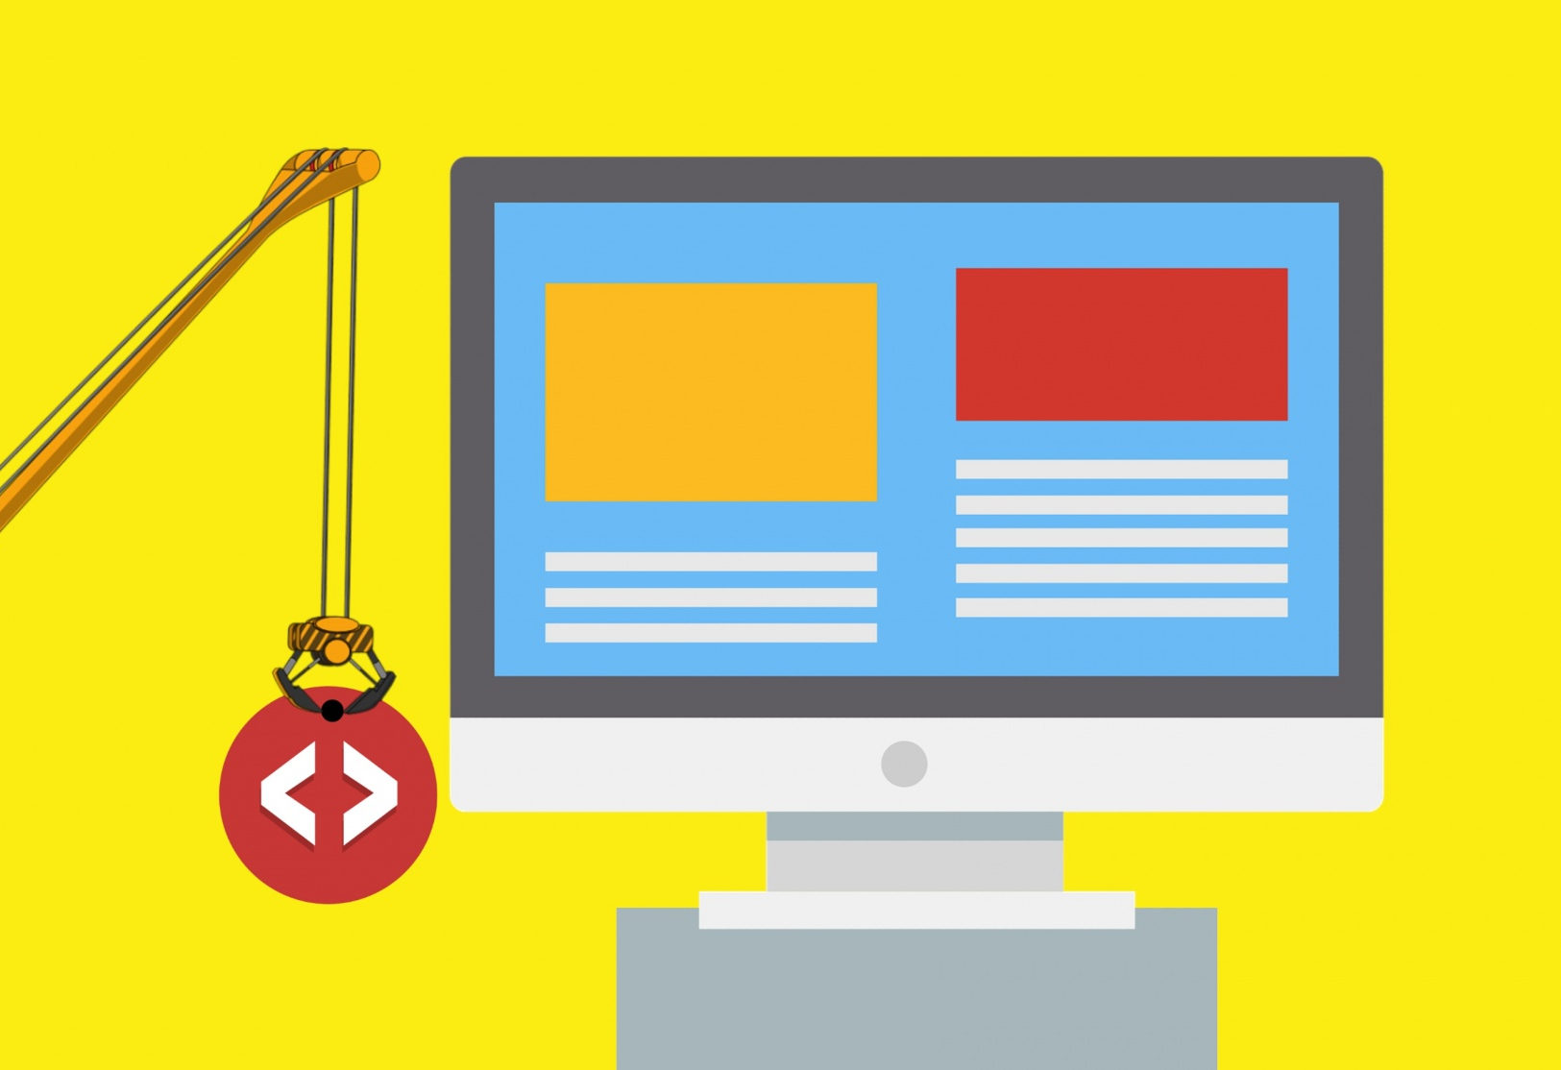
WEB DEVELOPMENT
-PRESENTED BY
SAHIL KUMAR

Slide 2
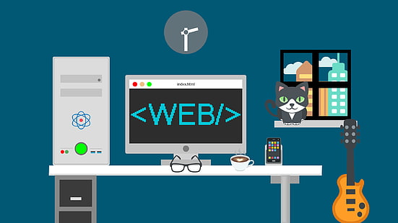

Slide 3
What is Web Development?
Web development is the work involved in developing a Web site for the Internet (World Wide Web) or an intranet (a private network).^{[1]} Web development can range from developing a simple single static page of plain text to complex web applications, electronic businesses, and social network services. A more comprehensive list of tasks to which Web development commonly refers, may include Web engineering, Web design, Web content development, client liaison, client-side/server-side scripting, Web server and network security configuration, and e-commerce development.

Slide 4
Main components of a webpage :
HTML
CSS
Javascript

Slide 5
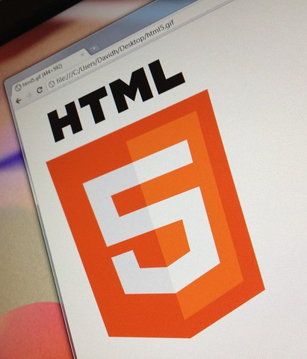
HTML 5
The HyperText Markup Language, or HTML is the standard markup language for documents designed to be displayed in a web browser. It can be assisted by technologies such as Cascading Style Sheets (CSS) and scripting languages such as JavaScript.
HTML elements are the building blocks of HTML pages.
HTML provides a means to create structured documents by denoting structural semantics for text such as headings, paragraphs, lists, links, quotes and other items.

Slide 6
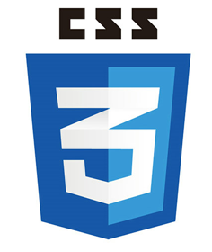
CSS 3
Cascading Style Sheets (CSS) is a style sheet language used for describing the presentation of a document written in a markup language such as HTML.CSS is a cornerstone technology of the World Wide Web, alongside HTML and JavaScript.
CSS is designed to enable the separation of presentation and content, including layout, colors, and fonts.
The name cascading comes from the specified priority scheme to determine which style rule applies if more than one rule matches a particular element.

Slide 7

JavaScript 5
JavaScript is the world's most popular programming language. JavaScript is the programming language of the Web.
Alongside HTML and CSS, JavaScript is one of the core technologies of the World Wide Web. Over 97% of websites use it client-side for web page behavior,often incorporating third-party libraries.
Although there are similarities between JavaScript and Java, including language name, syntax, and respective standard libraries, the two languages are distinct and differ greatly in design.

Slide 8
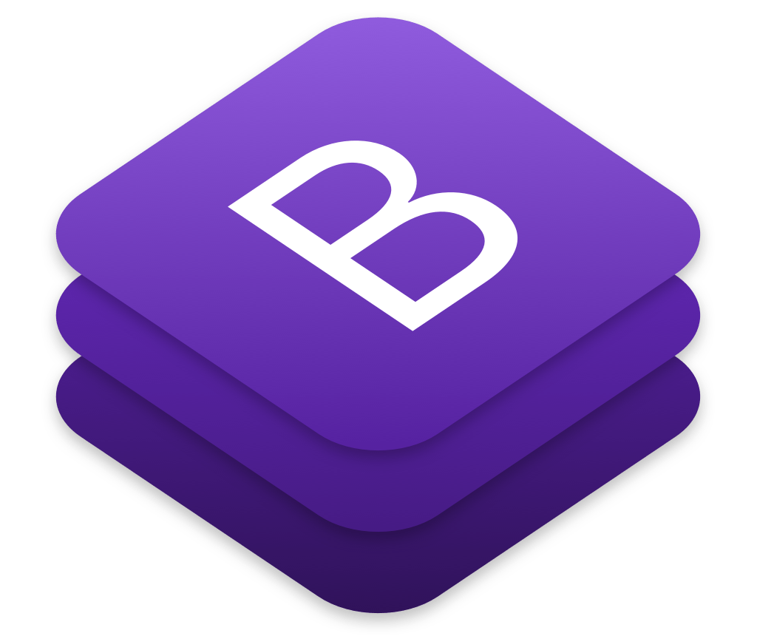
Bootstrap 5
Bootstrap is a free and open-source CSS framework directed at responsive, mobile-first front-end web development. It contains CSS- and JavaScript-based design templates for typography, forms, buttons, navigation, and other interface components.

Slide 9
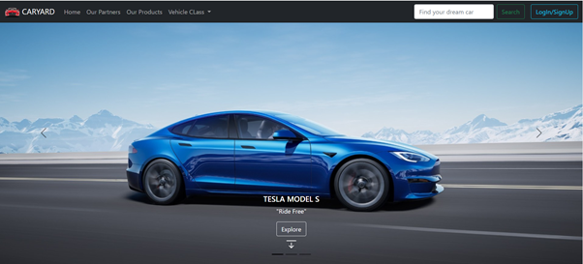
Final Project Glimpse

Slide 10
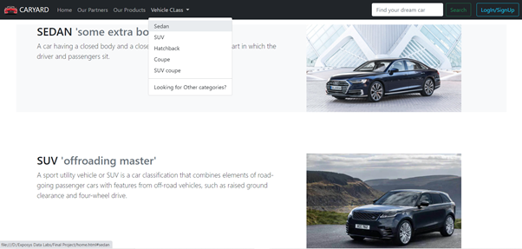
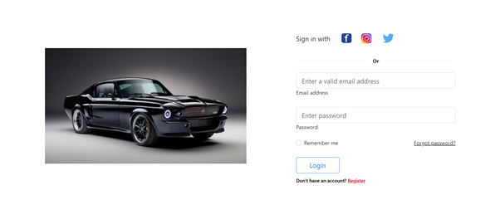

Slide 11
Conclusion:
The main aim of this project was to design a multi-page responsive webpage which can be used in all the devices of different screen ratios.
The approach used is as follows:
Used HTML to build the structure of the webpage, then usedBootstrap (CSS framework) for various components and some CSS wherever required, at the end used the <scripts> to include javascript.

Slide 12


